Slide 1


Slide 2
Introduction
Capital budgeting is a financial process used to evaluate investment opportunities. It helps organizations make informed decisions by analyzing potential projects’ costs and benefits.
Capital budgeting is the process of planning and managing a firm’s long-term investments. It aims to identify projects that enhance firm value. It focuses on investments that involve substantial capital expenditure and are expected to generate returns over several years.

Slide 3
Definition by Different Theorists
According to Charles T. Horngreen, “Capital budgeting is long-term planning for making and financing proposed capital outlays.”
According to G.C. Philippatos, “Capital budgeting is concerned with the allocation of the firm’s scarce financial resources among the available investment opportunities. The selection of a given project implies the acceptance of its probable stream of net benefits in future.”
According to L.J. Gitman, “Capital budgeting is the whole process of analyzing projects and deciding whether they should be included in the capital expenditure programme.”

Slide 4
Importance of Capital Budgeting
Helps in long-term strategic planning.
Ensures efficient use of limited resources.
Reduces the risk of over- or under-investment.
Directly influences profitability, growth, and sustainability.
Aligns investments with the goal of wealth maximization

Slide 5
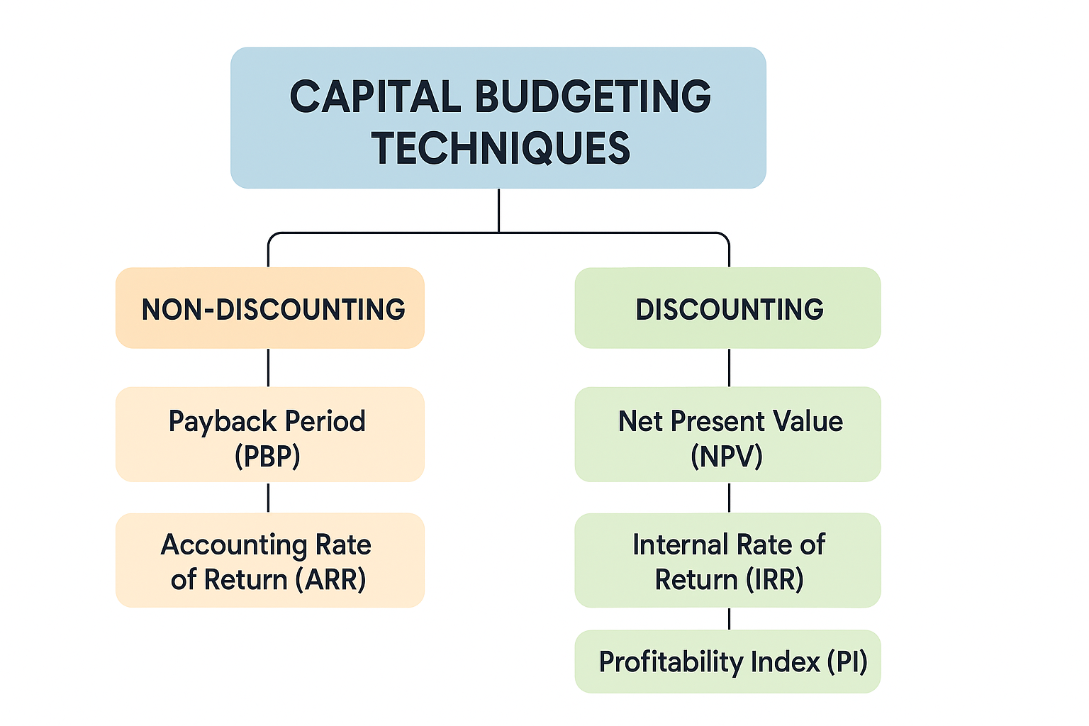
Capital Budgeting Techniques

Slide 6
Traditional/ Non-Discounting Techniques
Payback Period – This method is the simplest and most widely used. The payback period calculates the time required to recover the initial investment from the cash inflows generated by the project. A shorter payback period is generally preferred because it implies quicker recovery and less risk.
Payback Period = Annual Cash Inflow
Initial Investment
Merits:
Simple and easy to use.
Helps to measure risk (shorter payback = less risk).
Demerits:
Ignores cash inflows after payback period.
Ignores the time value of money.

Slide 7
Average Rate of Return – ARR means the average annual earning on the project. Measures expected return based on accounting profits rather than cash flows.
ARR = Average Annual Accounting Profit * 100
Initial or Average Investment
Merits:
  Uses accounting data that is readily available.
  Simple to understand.
Demerits:
  Ignores the time value of money.
  Based on accounting profit, not cash inflows. So, it is less reliable.

Slide 8
Modern/ Discounting Technique
Net Present Value Method – It is one of the most popular and reliable methods for the evaluation of an investment proposal. In this method, the difference between the present value (PV) of cash inflows and the PV of cash outflows is calculated. This method considers the time value of money.
NPV = PV of Cash Inflows- PV of Cash Outflows
Decision Rule:
  Accept if NPV > 0 (profitable)
  Reject if NPV < 0
  Indifferent if NPV = 0

Slide 9
Merits of Net Present Value Method
This method recognizes the time value of money. Cash inflows arising at different time intervals are discounted to present values.
This method recognizes the risk involved in the project with the help of the discount rate.
This method is best for mutually exclusive projects where only one project is to be selected among many.
This method is considered best for wealth maximization of shareholders as it is based on cash inflow rather than accounting profit.
It considers total benefits arising out of the project till the end of the project.

Slide 10
Demerits of Net Present Value Method
It requires difficult calculation.
The NPV technique requires the predetermination of the required rate of return, which itself is a difficult job. If that rate is not correctly taken, then the whole exercise of NPV may give a wrong result.
It does not provide a measure of the project's own rate of return; rather, it evaluates a proposal against an external variable, i.e., the minimum rate of return.
This method may not provide satisfactory results in case of projects having different amounts of investment and different economic lives.

Slide 11
Profitability Index Method – This method is closely related to NPV as it measures the ratio of the present value of Cash Inflows to the present value of Cash Outflows. This method is also known as Benefit-Cost Ratio Method.
Profitability Index = PV of Cash Inflows
PV of Cash Outflows
Decision Rule:
Accept if PI > 1 (Profitable)
Reject if PI < 1
Indifferent if PI = 0

Slide 12
Merits of Profitability Index Method
It is superior to NPV method as it gives due consideration to the time value of money and cost involved in the project.
In PI, all cash flows are considered, including working capital used and released; salvage value is also considered.
This method is considered best for wealth maximization of shareholders as it is based on cash inflow rather than accounting profit.
It considers total benefits arising out of the project till the end of the project.
The discount rate applied for discounting the cash flows is actually the minimum required rate of return. This minimum rate of return incorporates both the pure return and the premium required to offset the risk.

Slide 13
Internal Rate of Return Method - This method is also known as the Time-adjusted rate of return. IRR is the rate at which NPV of a project becomes zero. In other words, we could say that IRR is the rate at which the present value of cash inflows and the present value of cash outflows will be equal. In this method, the discount rate is to be ascertained by the trial-and-error method.
Decision Rule:
Accept if IRR > Cost of Capital
Reject if IRR < Cost of Capital
Indifferent if IRR = Cost of Capital
.

Slide 14
Merits of Internal Rate of Return Method
It takes into account the time value of money. Thus, cash inflows occurring at different time intervals are adjusted with an appropriate discount rate.
It is a profit-oriented concept and helps in selecting those proposals that are expected to earn more than the minimum required rate of return.
It is based on cash flow
Demerits of Internal Rate of Return Method
It involves complicated trial and calculation.
It makes an implied assumption that the future cash inflows of a proposal are reinvested at a rate equal to IRR. This assumption is not true as the firms are able to reinvest only at the rate available in the market.

Slide 15
Conclusion
Capital budgeting is a crucial financial management tool that helps organizations make long-term investment decisions. By evaluating potential projects using techniques such as Payback Period, Net Present Value (NPV), Internal Rate of Return (IRR), Profitability Index, and Accounting Rate of Return (ARR), businesses can identify investments that maximize profitability and minimize risk. Effective capital budgeting ensures optimal allocation of scarce resources, supports strategic growth, and contributes to the long-term wealth maximization of the firm. Ultimately, it provides a systematic approach to decision-making, helping managers balance risk and return while planning for sustainable financial success.

